Slide 1

Web Development with .NET Lecture 4: ADO.NET Part I, ASP.NET AJAX Part II 15 February 2010
MET CS 651 - Chelmsford
“Expert AJAX”

Slide 2
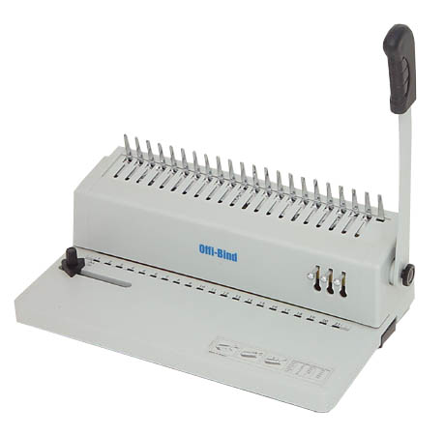

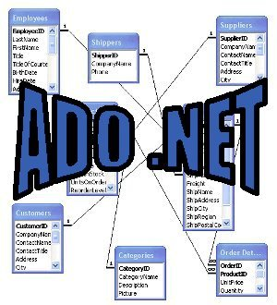
ADO.NET
Data Binding with ASP.NET, Part I:

Slide 3
Data-driven apps and scalable apps
Typically, web applications are data-driven applications
.NET provides a data programming technology for you, called ADO.NET
A number of managed classes that enable your app to connect to data sources, execute commands, and manage disconnected data
Scalability is achieved by breaking an application into functional tiers: presentation, business logic, and data tier
Keeping state between tiers is at high cost for scalability, performance, and security
The cost of maintaining state between tiers can be much higher than preserving View State. Large amounts of data, called data sets may have to be passed between them
ADO.NET offers a disconnected model that enables you to access data from one tier, disconnect from that tier (breaking state), and access that data locally
At the core of this model is the DataSet object

Slide 4
Using ADO.NET
You use a .NET data provider to connect to the data store
ADO.NET ships with a number of built-in providers, including SQLServer, and Oracle
The main classes in this provider model are:
Connection: Manage the db connection
Command: To create and execute SQL statements against the db or to access stored procedures already on the db and execute them
DataReader: To access data in a read-only manner, moving forward through the data as you read (lightweight and fast)
DataAdapter: Does the data transfer between the db and the DataSet
DataSet: A disconnected representation of all or part of the db. Supports a collection of tables, relationships, constraints, etc.
There are also OLEDB abd ODBC providers, to provide connectivity to any OLEDB or ODBC dbs
3rd party ecosystem of providers around open-source dbs such as MySQL and PostGreSQL has evolved..

Slide 5
SQLServer Express
Downoad and install it, with the Management Studio option
Install the AdventureWorks database and attach it in Management Studio
Connection Strings (visual design)
Data-Binding with SQLDataSource
T-SQL

Slide 6
Server-side Template-driven Rendering
The GridView Control
The DataList Control
for read-only data
Website 2b (1_WebForm.aspx)

Slide 7

Optimizing client-Server Communication
XML Web Services, Scriptable Web Services, and PageMethods

Slide 8
Web Services
XML, SOAP, WSDL
Scriptable: JSON
Creating a Web Service (Scriptable or not)
Creating a Web Service client

Slide 9
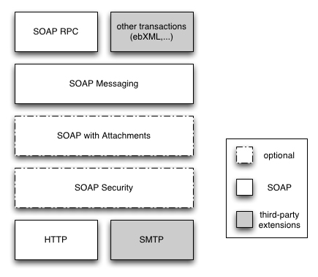

SOAP Stack

Slide 10
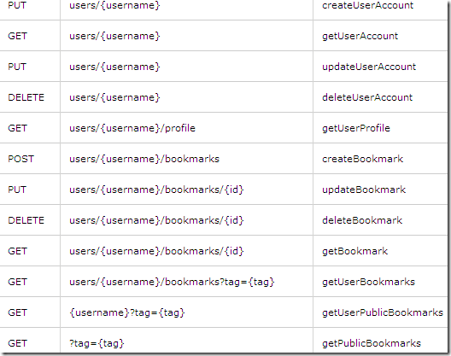
RESTful Web

Slide 11
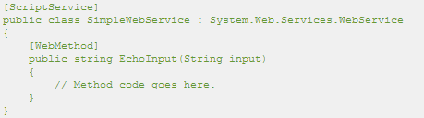
Calling Web Services from Script
Microsoft ASP.NET AJAX enables you to call ASP.NET Web services (.asmx files) from the browser by using client script
This enhances the user experience for the Web application because the page can call server-based methods without a postback, and without refreshing the whole page
Only data is transferred between the browser and the Web server
ASP.NET AJAX automatically creates JavaScript proxy classes for Web services
In order for a Web service to be accessed from script, it must be an .asmx Web service whose Web service class is qualified with the [ScriptServiceAttribute] attribute

Slide 12

Calling Web services from script
Steps:
Add ScriptManager control to the web page
ScriptManager control takes care of generating appropriate script references for ASP.NET AJAX framework scripts
Web service method is invoked as a regular function call in JavaScript
The ASP.NET framework takes care of the construction of the URL, sending calls to the web service, and parsing the return values. Details of the XMLHttpRequest object are completely shielded

Slide 13
Calling static methods from script
You can add static page methods to an ASP.NET page and qualify them as Web methods!
You can then call these methods from script as if they were part of a Web service, but without creating a separate .asmx file
To create Web methods in a page, import the System.Web.Services namespace and add a WebMethodAttribute attribute to each static method that you want to expose
To be able to call static page methods as Web methods, you must set the EnablePageMethods attribute of the ScriptManager control to true
A PageMethod is a public static method that is exposed in the code-behind of an aspx page and is callable from the client script

Slide 14
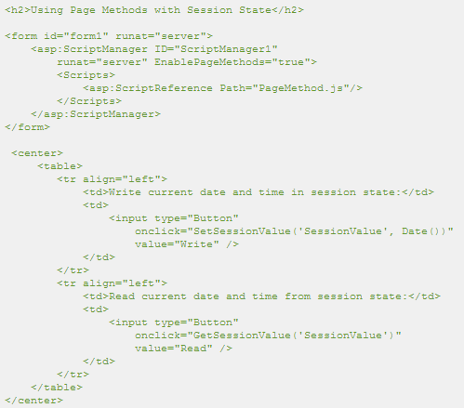
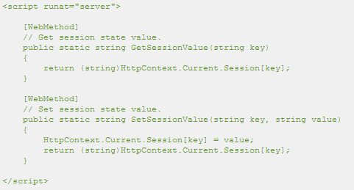
Calling static methods from script

Slide 15

HTTP GET access
You may have to enable the HTTP GET access to ASP.NET web services in the web.config file. This can be done by adding a configuration entry to the web.config, as shown in the following listing

Slide 16
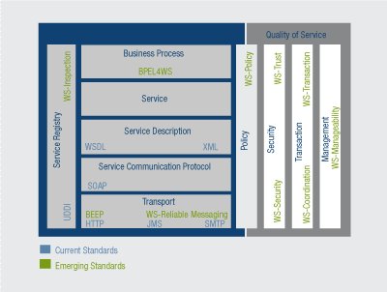
WS Standards, current & emerging

Slide 17

Deep dive
ASP.NET AJAX

Slide 18
Really, what is AJAX?
AJAX is about minimizing the number of full page reloads
A “true” or “pure” AJAX application makes use of the XMLHttpRequest Object to bypass the browser and establish direct communication with the Web server
Pages that use ScriptManager and Update Panel to do partial rendering (“poor man’s” AJAX) still do a Postback, albeit on a smaller page section, and carry an important load of View State
Based on the XMLHttpRequest strategy, a number of AJAX Frameworks have been designed, and one of these is ASP.NET AJAX
ASP.NET AJAX shines in in the support it provides to access server-side code
Connecting to a scriptable Web service or WCF service is child’s play for a developer: Call the method asynchronously and get a Data Transfer Object (DTO) back with its own properties
ASP.NET AJAX however still does not provide a lot of support for manipulating downloaded data on the browser

Slide 19
AJAX Definition
Ajax isn’t a technology. It’s really several technologies, each flourishing in its own right, coming together in powerful new ways. Ajax incorporates:
Standards-based presentation using XHTML and CSS;
Dynamic display and interaction using the Document Object Model (DOM)
Data interchange and manipulation using XML and XSLT (and JSON)
Asynchronous data retrieval using XMLHttpRequest
JavaScript binding everything together

Slide 20
Rewind: Classic Web app
Most user actions in the interface trigger an HTTP request back to a web server
The server does some processing — retrieving data, crunching numbers, talking to various legacy systems —
Then returns an HTML page to the client
It’s a model adapted from the Web’s original use as a hypertext medium

Slide 21
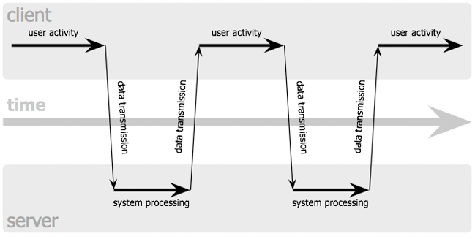
Classic Web App (synchronous)

Slide 22
Fast forward: AJAX App
An Ajax application eliminates the start-stop-start-stop nature of interaction on the Web by introducing an intermediary — an Ajax engine — between the user and the server
Instead of loading a webpage, at the start of the session, the browser loads an Ajax engine — written in JavaScript and usually tucked away in a hidden frame
This engine is responsible for both rendering the interface the user sees and communicating with the server on the user’s behalf
The Ajax engine allows the user’s interaction with the application to happen asynchronously — independent of communication with the server
So the user is never staring at a blank browser window and an hourglass icon, waiting around for the server to do something

Slide 23
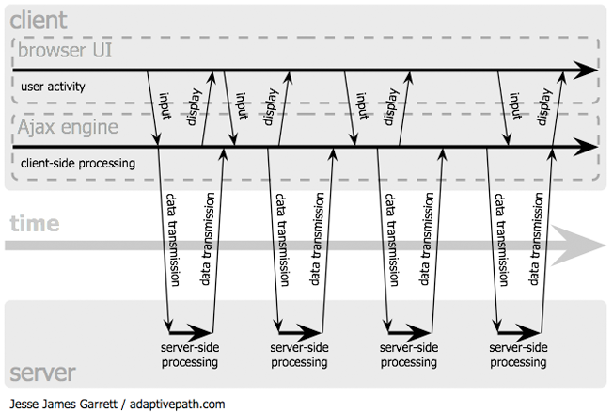
AJAX App model (asynchronous)

Slide 24
AJAX Apps
Gmail, Google Groups, Google Maps, etc.

Slide 25
AJAX with Script injection
Script injection (ASP.NET 2.0) allows controls to call server-side code on a page without a full postback
The callback mechanism is used by the TreeView control (to expand nodes on demand), the GridView control (for sorting and paging), and the DetailsView control (for paging)
Remember steps involved in using callbacks (from last lecture):
Implement the ICallbackEventHandler interface in the control or the Page class
Client calls RaiseCallbackEvent() to raise the event on the server, GetCallbackResult() returns string value to client
Generate the client-side script that will invoke the callback
Calling the GetCallbackEventReference() method of ClientScriptManager
Write code that invokes the client script code generated in step 2 (probably in an event handler)

Slide 26
AJAX with XMLHttpRequest
Steps involved in using the XMLHttpRequest object:
Instantiate the XMLHttpRequest object
Call the open method on the XMLHttpRequest object
The first parameter is the HTTP method to use, which is either GET or POST. The second parameter is the URL of the resource that you want to access using the object
Provide a handler to the onreadystatechange event
The handler will be called by the object as its state changes. The bulk of the work is done in this handler. In the listing, we assign an anonymous function to handle this event
Call the send method
The send method can take the contents of the request as a string. This is useful for posting to the server using HTTP POST
When the HTTP request ends, either successfully or with errors, the readyState of the XMLHttpRequest object is set to 4, which means complete
You have to figure whether the request was successful or not using the status property which returns one of the HTTP status codes

Slide 27
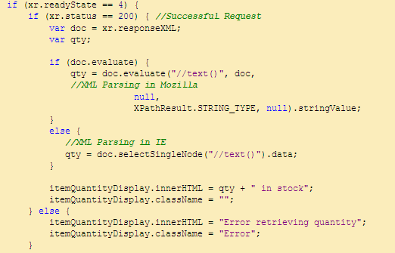
HTTP Status codes
Response is an XML document, and we need to extract the item quantity from the XML DOM document
Since the quantity of the item is send as text of the root document, the XPATH //text() will work for us
The exact method of using XPath is different for Internet Explorer and Mozilla Firefox
In Internet Explorer, you can use the selectSingleNode function, which is not available in Mozilla where you have to use the evaluate method

Slide 28
HTTP Error codes
C:\WINDOWS\Help\iisHelp\common

Slide 29
AJAX with Partial Rendering (Script Manager and Update Panel)
A Postback is still occurring…
The entire Web page payload gets uploaded to the server
The part of the Web page within the Update Panel gets downloaded (with relevant View State)
Data is merged with presentation markup and can’t be separated from it
Other Update Panels may stop functioning if another partial rendering operation is ongoing
Website1
While quick to develop, Partial rendering may not be the ideal mechanism to deploy
Website 1b
But XMLHttpRequest use is complex…

Slide 30
Pure AJAX Architecture with Client-side Presentation Assistance
Can we improve on Website2b (2_UpdatePanel.aspx)?
Let’s reconsider Website2 with a pure AJAX architecture
Invoke an HTTP endpoint backed by a scriptable Web service (or WCF service)
No page lifecycle or postback events, no View State restoration: Network traffic an order of magnitude smaller
2 neatly separated blocks of code at work: Client-side front-end presentation layer powered by Javascript, and server-side back-end business layer powered by managed code
Scriptable Web Services do not return data in XML, but in JSON notation (no SOAP!)
Data can be cached on the server or the client, and what’s cached are usable objects (JSON)
ASP.NET AJAX give you a Javascript proxy object with the same monicker as the server-side service and a bunch of static methods
Unfortunately, there’s no client-side GridView control…
We need a form of client-side data-binding…

Slide 31
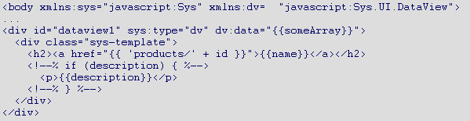
ASP.NET 4.0 AJAX with Client-side templates
Template-driven rendering has long been one of the major strengths of ASP.NET server controls
Templates offer a number of advantages over older techniques of looping around markup using <% %> blocks
There is a lot more to templates than just inserting data into placeholders in an HTML string
A Template engine must have some sort of expression language to go beyond simple field insertion
It should enable scenarios of conditional rendering
It should be simple to add rich behavior to the rendered markup
ASP.NET AJAX 4.0 Template engine preview

Slide 32
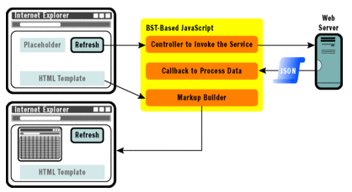
Client-side Templates with ASP.NET 3.5
Download MicrosoftAjaxTemplates.js javascript
Website2b (3_Client.aspx)

Slide 33
ASP.NET Web Forms or ASP.NET Handlers?
A file with the .ashx file extension is an ASP.NET Web Handler file
Handlers are better for binary data, and web forms are best for text data
When a request for a page comes into ASP.NET, eventually that request is handled by an object that implements the IHttpHandler interface
This interface includes a method called ProcessRequest that is responsible for writing all of the page content to the HttpContext.Response.Output stream
ASHX files allow you to easily write the IHttpHandler class without having to pre-compile it
Read “ASP.NET ASHX Handler Tutorial”, and “Writing a Generic Handler” documents on Blackboard

Slide 34
Live Binding
Live binding is having the data bound in real-time
When there's any change in the data source, the changes are reflected to the data bound interface instantly and vice versa.
If you are using an edit template for updating the data of a selected row of the table, the data in the table will get updated as you change a field in your edit form if both the table and the form use "Live Binding". Pretty cool, right?
This is all done through client-side script, JavaScript
The core of the live binding is the implementation of an "Observer" pattern
The observer pattern enables an object to be notified about changes that occur in another object
ASP.NET AJAX 4.0 implements this pattern completely. It adds observer functionality to ordinary JavaScript objects or arrays so that they raise change notifications when they are modified through the Sys.Observer interface
Website3, Website4

Slide 35
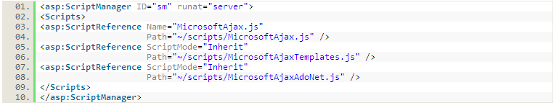
Live Binding in Action
To implement live binding, you will need the ASP.NET AJAX 4.0 framework included in your project, like so:
Or you can use ScriptReferences under a ScriptManager tag, like so:
3 files in this package, an updated MicrosoftAjax.js file and 2 new: MicrosoftAjaxTemplates.js (for the client template support) and MicrosoftAjaxAdoNet.js (for ADO.NET utilities)
The key components used for the Live Binding are Templates, the DataView control and the DataContext class. AdoNetDataContext class for additional ADO.NET support

Slide 36
Client-side Data-binding with DataView
This control can bind to any JavaScript object, array or even ASP.NET AJAX component. To use a DataView control in your page, the following declarative initialization process is needed:
The value of the "activate" attributes are the comma separated IDs for the HTML components in which the observer is applied to check for changes
Using an * here implies to activate all the HTML components to be observable (but this might get the page rendering speed to be slower)

Slide 37

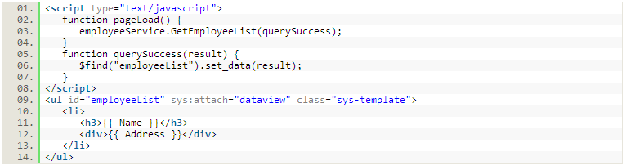
Providing Data to DataView Control
Setting the data property of the control decoratively:
Setting the data property of the control through code:

Slide 38
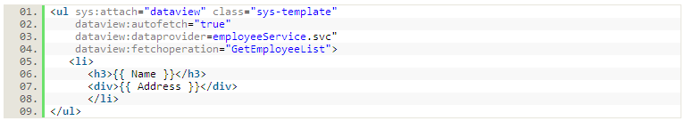
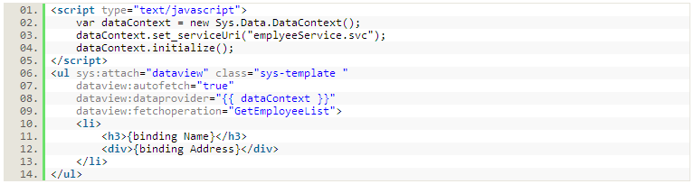
Providing Data to DataView Control
Using WCF or ASP.NET Web Service as dataProvider:
A WCF or ASP.NET web service can be specified in the dataProvider property of the control
Using DataContext classes as dataProvider:
If you are using an ADO.NET data service, you should use the AdoNetDataContext class instead of the more general-purpose DataContext class

Slide 39
One-way/One-time/Two-way Binding
In the above examples you see a binding syntax like this: { { expression } }
This is a one-way/one-time data binding as the expression is evaluated only once, at the time of template rendering
With one-way/one-time binding, if the source data changes after the template has been rendered, the rendered value will not be automatically updated
Another syntax is available to ensure the target value is updated with the change of source value, which is like this: { expression }
In two-way live binding, the binding works in both directions. If the target value is changed (in this case, the value in the UI), the source value is automatically updated (in this case, the underlying data item)
Similarly, if the source value is changed (in this case, if the underlying data value is updated externally), the target value (the value in the UI) is updated in response. As a result, target and source are always in sync

Slide 40
Live Binding Syntax and WPF
The live-binding syntax is similar to binding syntax in WPF (XAML)
It can be used for binding between UI and data, as in the above examples, as well as directly between UI elements, between data and properties of declaratively attached controls and components, and so on
In the following example, if the user modifies the values in the text boxes, the values in the h3 and div elements will change automatically

Slide 41
Additional Features
The syntax also provides functions for converting data values to rendered values, or converting back from values entered in UI to an appropriately formatted data value. The following example shows how to provide conversion functions:
This similar syntax can be used to specify binding mode as well:
The default binding behavior for text-boxes and other input controls is two-way and for all other controls is one-way

Slide 42
Javascript and ASP.NET Extensions
A simple programming language whose foundation was laid out quite a few years ago when
Object oriented programming was considered overkill for the Web
Principles of dynamic languages were considered too academic
As a result, Javascript supports some OO semantics with a bit of inheritance through object prototypes and encapsulation with closurs, and a number of dynamic binding features as in today’s Ruby/Python
Javascript is the language of the client-side Web (prior to Flash and Silverlight)
Presentation elements such as buttons and textboxes are modeled after the schema defined in the DOM
Using Javascript, you can manipulate them, you can handle events, and you can use XmlHttpRequest, running more code on the client and less on the server
ASP.NET extensions make Javascript a tad bit more OO
Read Chapter 14 of the textbook (optional)

Slide 43
The Microsoft AJAX Library
Consists of two related parts:
Javascript Language extensions
A Base Class Library to provide predefined tools and services to developers
Self-contained, stored in couple of .js files:
MicrosoftAjax.js defines language extensions (namespaces, interfaces, enums, inheritance)
MicrosoftAjaxWebForms.js defines the partial rendering engine and the whole network stack
You don’t need to reference or embed these two files in your applications: The Scriptmanager Control does this for you
If you’re going to extend the capabilities of the browser’s Javascript in the context of an non-ASP.NET AJAX app, you are going to have to reference any required .js file explicitly <head> <script src=“microsoftajax.js” /> </head>
Source code at ajax.asp.net/downloads

Slide 44

HTTP Debugging
Fiddler

Slide 45
Fiddler
Fiddler is a HTTP Debugging Proxy which logs all HTTP traffic between your computer and the Internet. Fiddler allows you to inspect all HTTP Traffic, set breakpoints, and "fiddle" with incoming or outgoing data
Fiddler includes an event-based scripting subsystem, and can be extended using any .NET language
Fiddler is freeware and can debug traffic from any application, including Internet Explorer, Mozilla Firefox, Opera
There are two different versions of Fiddler available: Fiddler 1.x for .NET Framework version 1.1 users and Fiddler 2.x for users with .NET Framework version 2.0 or later installed
What Does Fiddler Capture?
Quick graph of data transferred during a session by file type
Request and response headers for cookies and form data
Show you just the raw data if that's what you want
Lets you make custom HTTP requests right from within Fiddler. You can use a previous request as a template and then modify it however you'd like

Slide 46
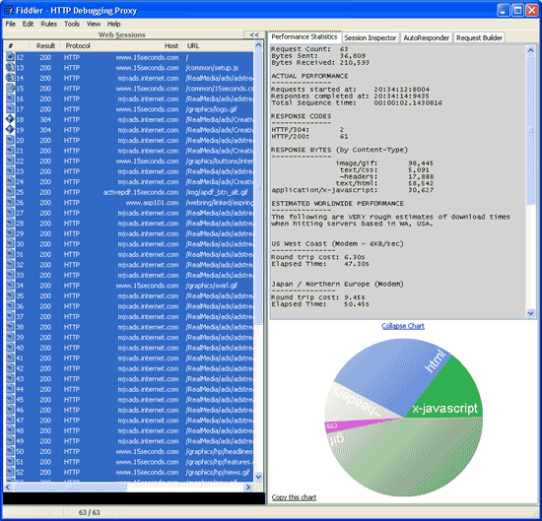
Fiddler Info

Slide 47
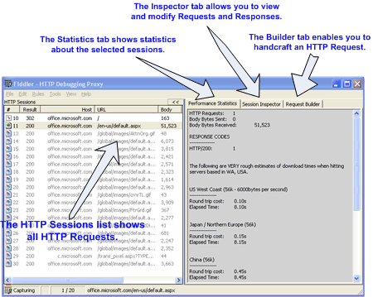
Fiddler Tabs

Slide 48
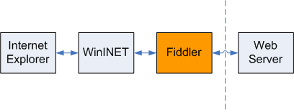
Fiddler How-to
After you start Fiddler, the program registers itself as the system proxy for Microsoft Windows Internet Services (WinInet), the HTTP layer used by Internet Explorer, Microsoft Office, etc.
You can verify that Fiddler is correctly intercepting requests by checking the Proxy Settings dialog: From the Internet Explorer main menu, click Tools, click Internet Options, click Connections, click LAN Setting, and finally click Advanced
As the system proxy, all HTTP requests from WinInet flow through Fiddler before reaching target Web servers Similarly, all HTTP responses flow through Fiddler before being returned to the client application
When you close Fiddler, it unregisters itself as the system proxy before shutting down

Slide 49
Using Fiddler for Debugging
In addition to seeing all HTTP requests and responses, Fiddler supports the notion of breakpoints
When the Enable Single Step Debugging option is checked on the Rules menu, or when the properties of the HTTP Request or Response match the target criteria, Fiddler can pause HTTP traffic and allow edits
This feature proves useful for security testing, as well as for general functionality testing, because all code paths can be exercised

Slide 50

Extending Fiddler Using Scripted Rules
Fiddler supports a JScript .NET event-handling engine that allows the user to automatically modify the HTTP request or response
The engine can modify the visual appearance of the session in the Fiddler user interface (UI), to draw attention to errors or to remove uninteresting sessions from the list altogether
The following sample code changes the UI to purple to show where cookies are uploaded

Slide 51
Extending Fiddler by Adding Inspectors
The user can add plug-in Inspector objects written in any .NET language
RequestInspectors and ResponseInspectors provide a format-specific or otherwise specialized view of HTTP request/response
Inspectors can be read-only (RO) or read-write (RW)
If an Inspector is read-write, it can be used to modify the HTTP request or response before the server or the client receives it
By default, Fiddler ships with the following Inspectors
Request Inspectors: [RW] Headers—Shows request headers and status, [RW] TextView—Shows the request body in a text box., [RW] HexView—Shows the request body in a hexadecimal view, [RO] XML—Shows the request body as XML DOM in a tree view
Response Inspectors: [RW] Transformer—Removes GZip, DEFLATE, and CHUNKED encodings for easier debugging, [RW] Headers—Shows response headers and status, [RW] TextView—Shows the response body in a text box, [RW] HexView—Shows the response body in a hexadecimal view, [RO] ImageView—Shows the response body as an Image. Supports all .NET image formats, [RO] XML—Shows the response body as an XML DOM in a tree view

Slide 52
Homework (lots of reading)
Read “ASP.NET ASHX Handler Tutorial”, and “Writing a Generic Handler” on blackboard
Read Chapters 3, 4, 5 (Web Forms, Web Services, and Data binding), and 11, 12, 13 (AJAX) in Lawrence Moroney textbook
Extra credit: Reimplement the Forward Caching Ajax Client example in the book on Chapter 11 (which doesn’t work), and fix it by using an ASP.NET Handler instead, using ideas in Website2b
Extra credit: Debug web site with Fiddler
Have you already downloaded and installed:
ASP.NET 2.0 AJAX Extensions 1.0
ASP.NET 2.0 AJAX Templates for VS2008/VS2010
AJAX Control Toolkit
Have you already downloaded and installed Microsoft SQLServer Express (free), with Enterprise Manager option??

Slide 53


